Slide 1
Chapter 2 : Basic Structures: Sets, Functions, Sequences, Sums, and Matrices
Sets: Subsets, Power Sets, Truth Sets and Quantifiers
Set Operations , Set Identities, Computer Representation of Sets

Slide 2
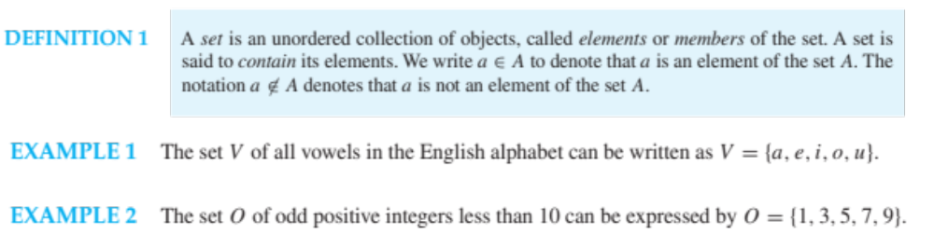


Slide 3
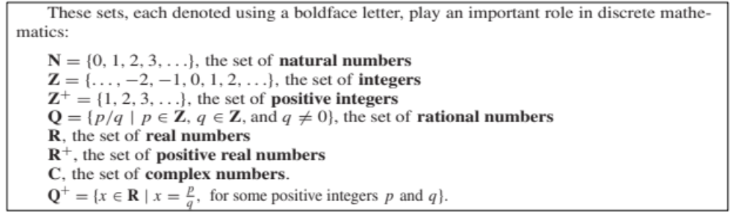
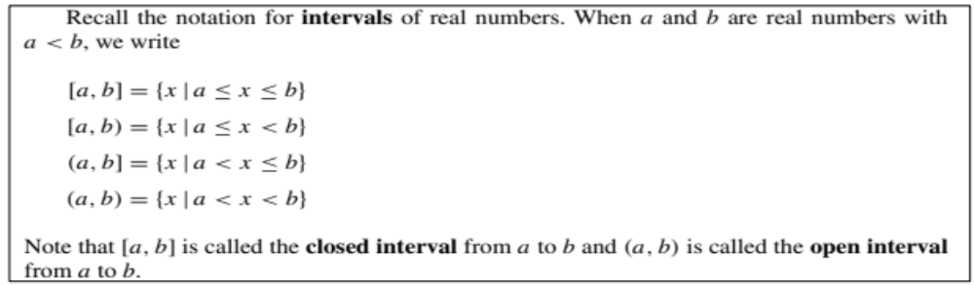

Slide 4
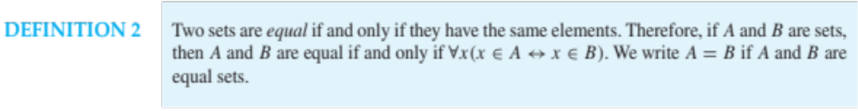

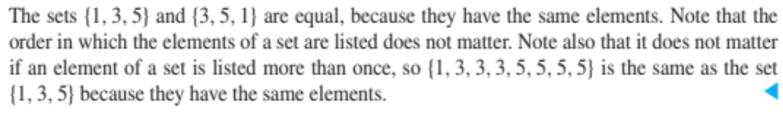
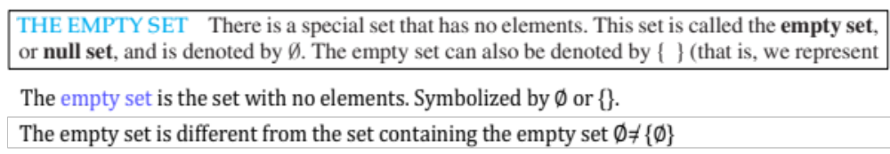

Slide 5
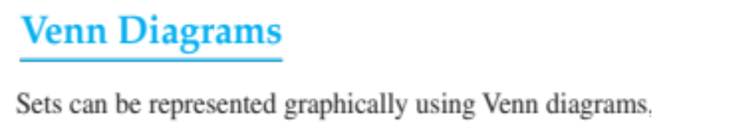

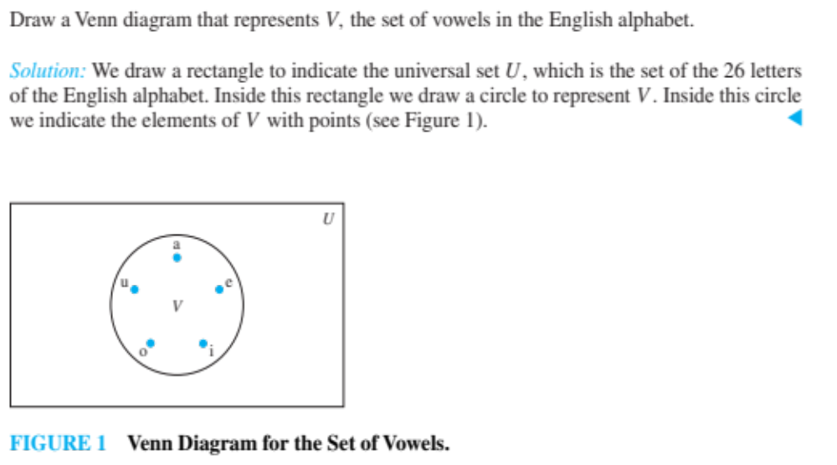

Slide 6
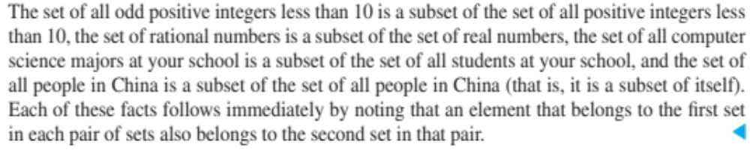


Slide 7
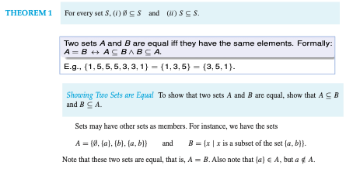

Slide 8


Slide 9


Slide 10


Slide 11
